Slide 1
Speech Commands Classification with Recurrent Neural Networks
Authors: Hubert Ruczyński, Patryk Tomaszewski 28th March 2023

Slide 2
01
Speech Commands Data Set

Slide 3

Speech Commands Data Set
Authors: Pete Warden
Year: 2018
Purpose: Benchmark for command speech recognition.
Specification: A data set of one-second .wav audio files containing one English word. Recordings from different people around the world, recorded with a 16000 sample rate.
Silence
Go
No
Bed
Happy
Marvin
Train obs. | Test obs. | Valid obs. | Sample rate | Duration | Classes | Max Acc
52 154 | 6971 | 6936 | 16000 | 1s | 11 (30) | 91%

Slide 4
02
Analysed architectures

Slide 5
Architectures
1. Single LSTM + 2 Dense Layers (128 relu, 12 softmax)
2. Bidirectional LSTM + Dense Layer (12 softmax)
3. One-Dimensional CNN (3 Convolutional layers + Max pooling) + 2 Dense Layers (128 relu, 12 softmax)
Before training, audio files were converted to Mel-Frequency Cepstral Coefficients.
Files shorter than one second have been right-padded with zeros.

Slide 6
03
Experiment 1: Architecture selection

Slide 7
PC Specification
Package | Version
scikit-learn | 1.2.2
keras cv | 0.3.5
tensorflow datasets | 4.8.3
keras | 2.10.0
pandas | 1.5.3
numpy | 1.24.2
seaborn | 0.12.2
matplotlib | 3.7.1
Keras-Preprocessing | 1.1.2
pyarrow | 11.0.0
tensorflow | 2.10.1
tqdm | 4.61.2
scipy | 1.10.1
pickleshare | 0.7.5
Component | Specification
OS | Windows 11
CUDA | CUDA 12.1.0
GPU | GPU Ge Force RTX 3070 Ti (24GB – 8GB/16GB)
CPU | Intel Core i7-11700KF 3.6GHz
RAM | 32GB

Slide 8
Experiment Description
Main goal: Choosing the best architecture.
Number of repetitions: 5
Computational time: 1 hour
Additional notes: All neural networks were our own implementations, and we didn’t use any pretrained architectures.
Learning rate: 0.001
Batch size: 64
Dropout rate: 0.2
Max epochs: 100

Slide 9
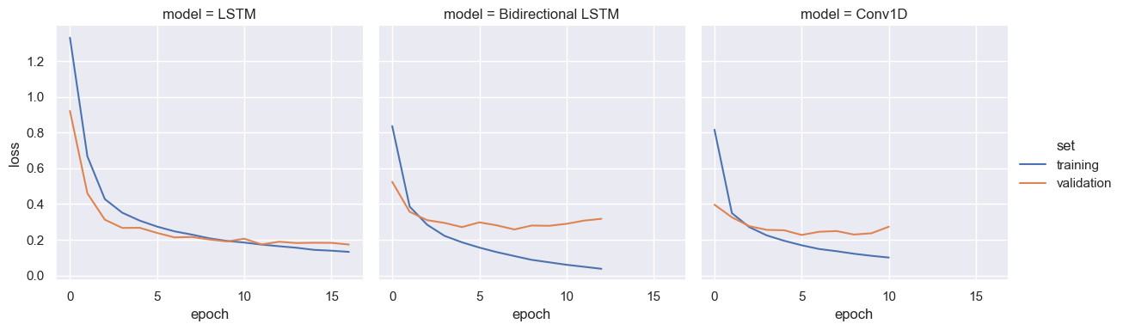
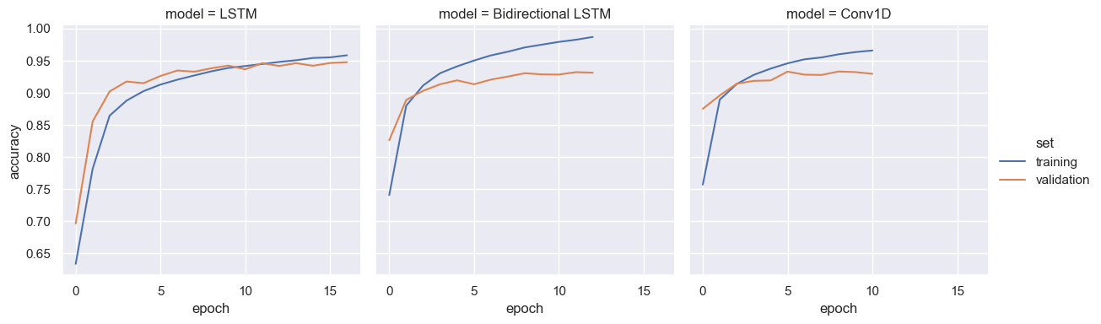
Learning curves

Slide 10
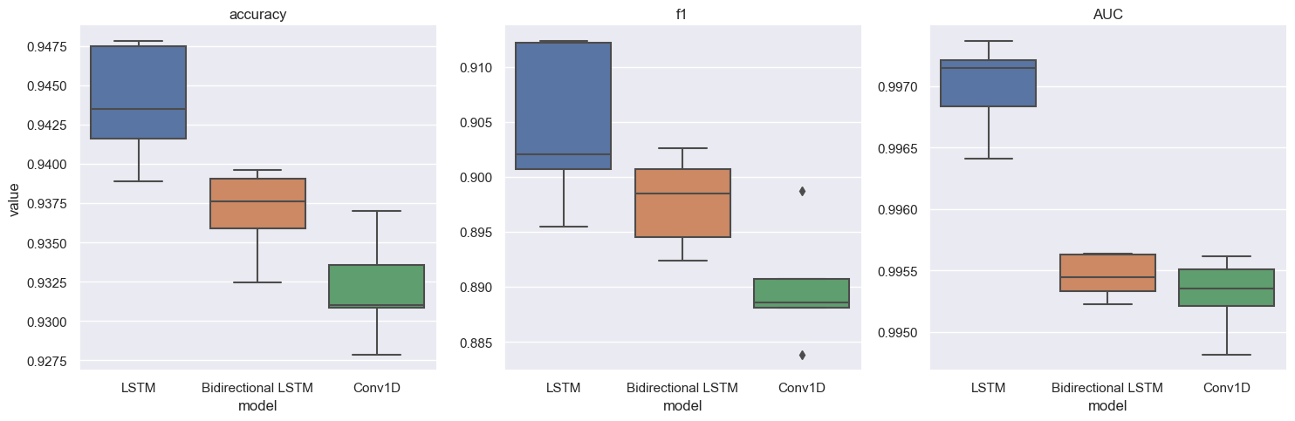
Performance comparison

Slide 11
04
Experiment 2: hyperparameter tuning

Slide 12
Experiment Description
Main goal: Analyse the impact of training hyper-parameters.
Secondary goal: Selecting the parameters for the final model.
Number of repetitions: 5
Computational time: 8h
Additional notes: In this experiment, we’ve run a grid search which resulted in training 27 models.
Learning rate | 0.0005 | 0.001 | 0.01
Batch size | 32 | 64 | 128
Dropout rate | 0 | 0.2 | 0.5

Slide 13
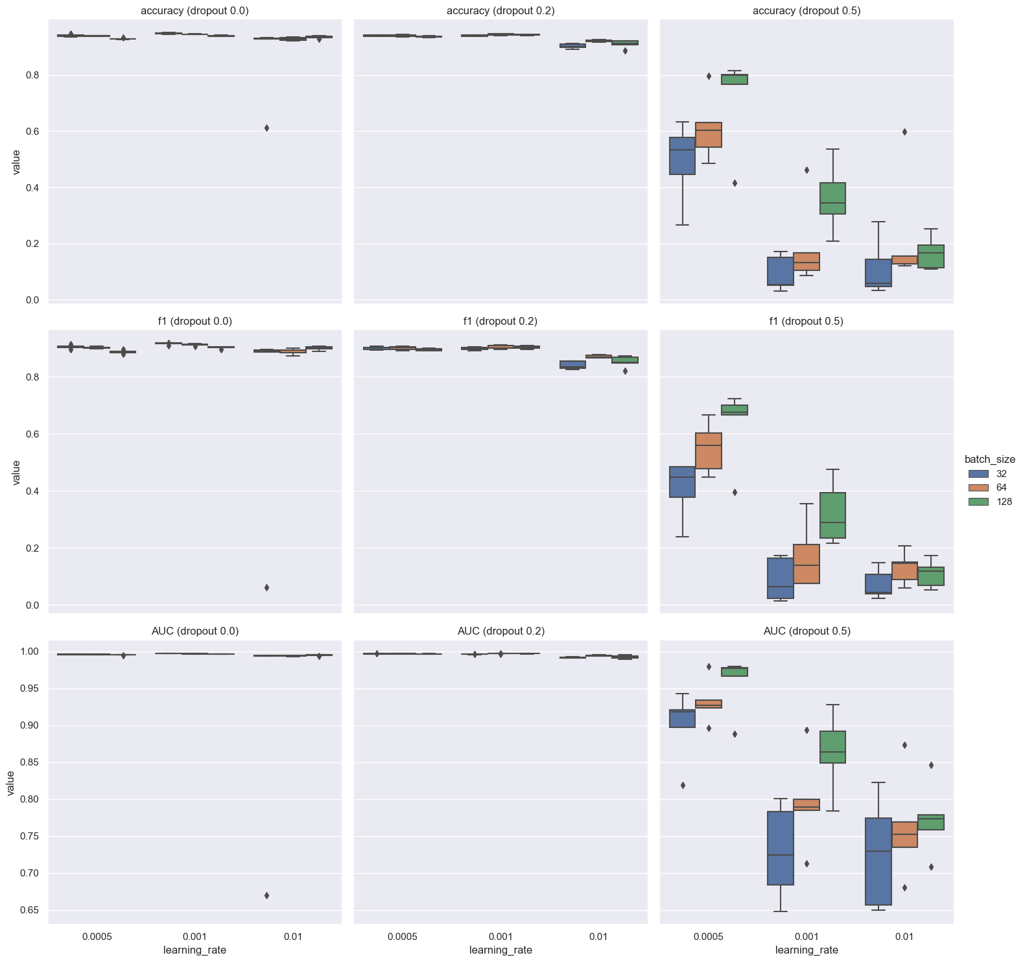
Grid search results

Slide 14
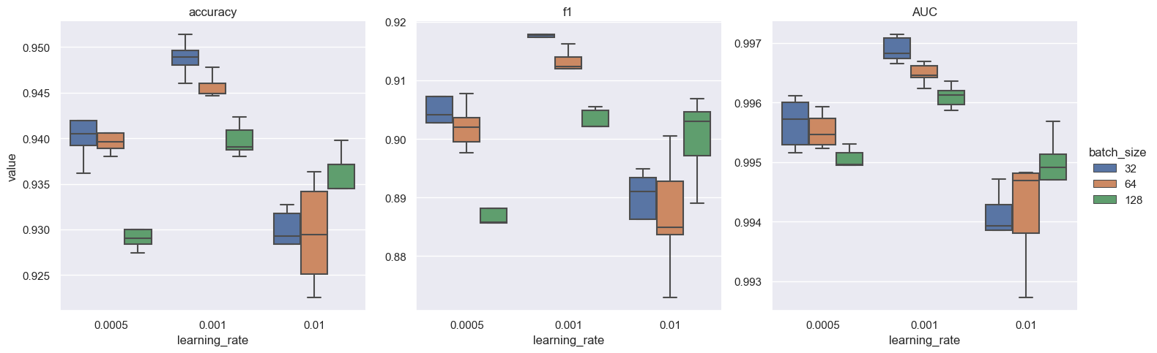
Results for dropout=0

Slide 15
05
Experiment 3: Handling "unknown" class

Slide 16
Experiment Description
Main goal: Minimizing the impact of the "unknown" class, which is 20 times bigger than other classes.
Number of repetitions: 1
Computational time: 1 hour
Additional notes: The models were trained with the best parameters, with addition of instance weights for the "unknown" class.
Learning rate: 0.001
Batch size: 32
Dropout rate: 0
Max_epochs: 100
Weights: 1, 0.25, 0.15, 0.05

Slide 17
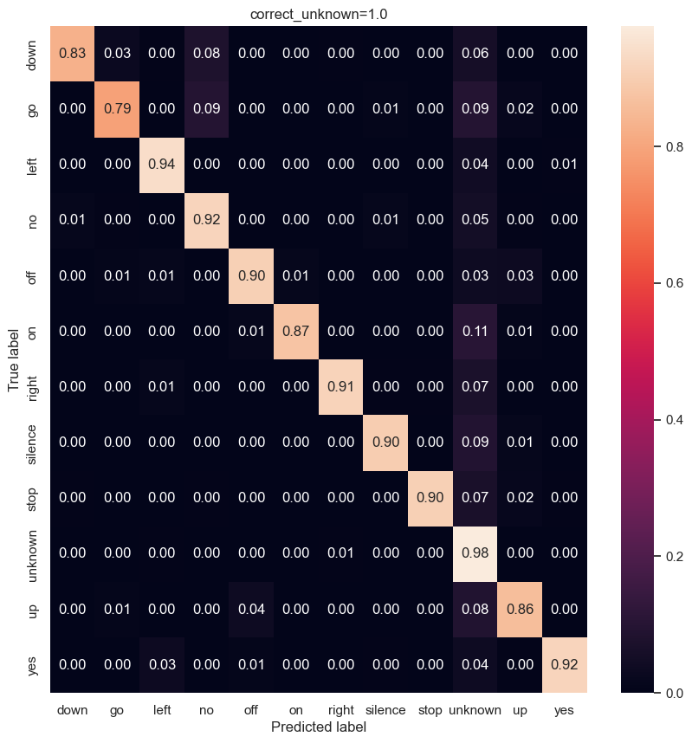
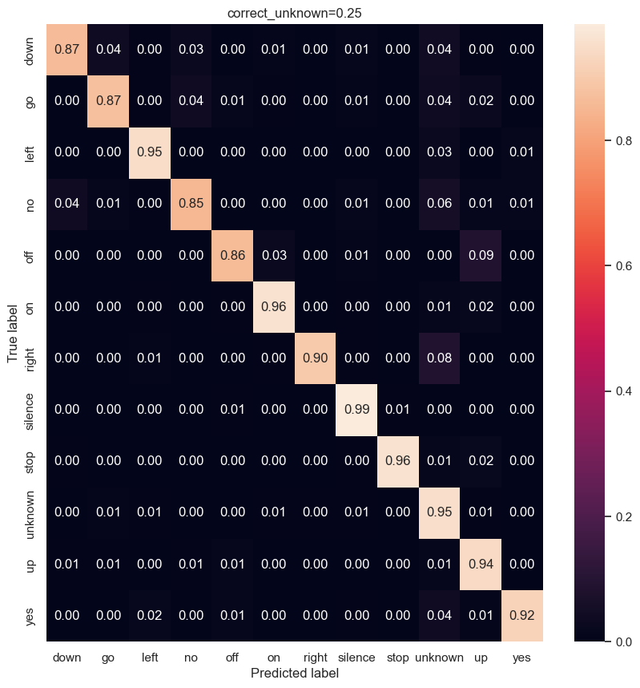
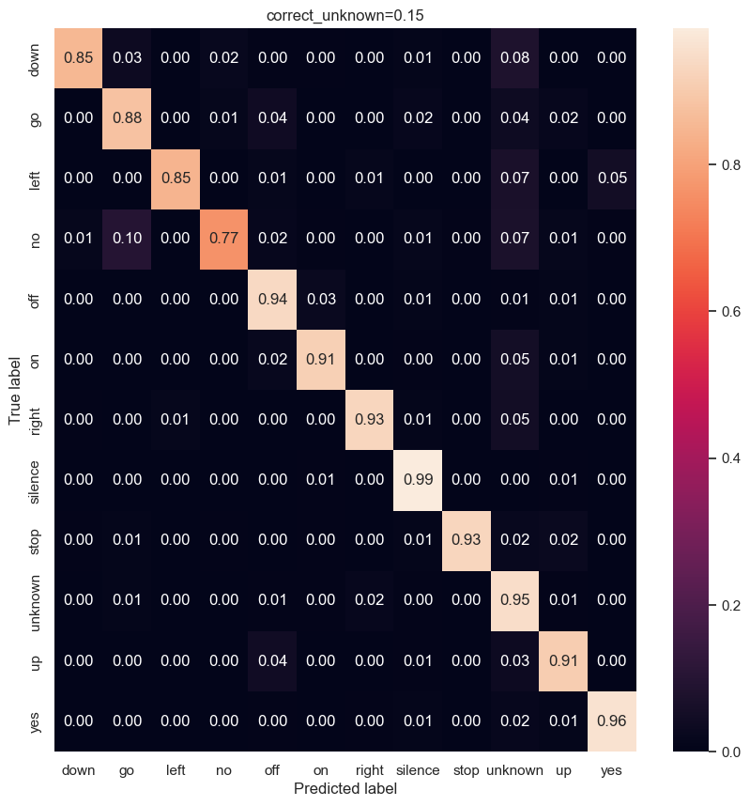
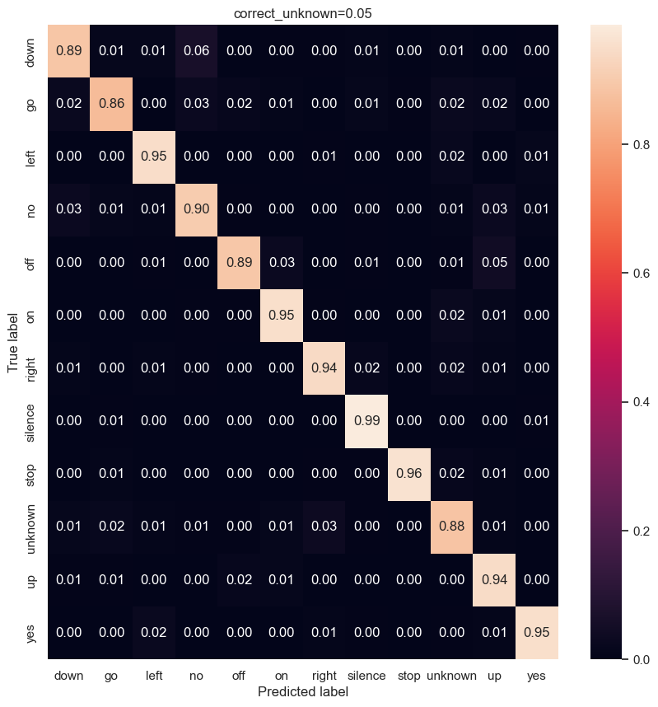
Confusion matrix
Weight | Accuracy | F1 | AUC
1 | 94.10% | 90.47% | 99.65%
0.25 | 93.65% | 89.81% | 99.57%
0.15 | 92.90% | 88.72% | 99.57%
0.05 | 90.13% | 86.55% | 99.46%

Slide 18
Confusion matrix
Weight | Accuracy | F1 | AUC
1 | 94.10% | 90.47% | 99.65%
0.25 | 93.65% | 89.81% | 99.57%
0.15 | 92.90% | 88.72% | 99.57%
0.05 | 90.13% | 86.55% | 99.46%

Slide 19
Confusion matrix
Weight | Accuracy | F1 | AUC
1 | 94.10% | 90.47% | 99.65%
0.25 | 93.65% | 89.81% | 99.57%
0.15 | 92.90% | 88.72% | 99.57%
0.05 | 90.13% | 86.55% | 99.46%

Slide 20
Confusion matrix
Weight | Accuracy | F1 | AUC
1 | 94.10% | 90.47% | 99.65%
0.25 | 93.65% | 89.81% | 99.57%
0.15 | 92.90% | 88.72% | 99.57%
0.05 | 90.13% | 86.55% | 99.46%

Slide 21
Confusion matrix
Weight | Accuracy | F1 | AUC
1 | 94.10% | 90.47% | 99.65%
0.25 | 93.65% | 89.81% | 99.57%
0.15 | 92.90% | 88.72% | 99.57%
0.05 | 90.13% | 86.55% | 99.46%

Slide 22
06
Kaggle results

Slide 23
Kaggle results
Architecture | Learning rate | Batch size | Dropout | Weight | Accuracy
LSTM | 0.001 | 32 | 0 | 0.05 | 78.57%

Slide 24
Thanks for attention!

